Slide 1
Online Doctor Appointment and Consultation System

Slide 2
Group Name: SoftwareEngineering5
Group Members:
Manvitha Chowdary Bandi
Meghana Pentyala
Anirudh Reddy Gade
Vagdevi Gudapati
Sreeja Reddy Chiligireddy
Mukunda priya Rachamalla
Sai Vamsi Krishna Kadiyala
Vaishnavi Gawni

Slide 3
Project Description:
Online Doctor Appointment and Consultation System is a web application used by doctors, users and pharmacies. Doctors can register in this website and post their profile such as expertization, experience, address, timings, fee details etc. This web site allows the users to book an appointment for consultation online or offline for a doctor regarding their health problems. Users after selection of a doctor in the web site the system ask the consultation fee and the payment will be performed online which is transferred to the doctors account. If the consultation is online then the doctor after consultation sends medicine prescription to the user account in the website and users can directly send same prescription of medicine to the pharmacies who already registered in the website which are nearest to user and pharmacies delivers medicines to the user door steps. This project Online Doctor Appointment and Consultation System aims to develop an application which simplifies the work and time of doctors, users and pharmacies.

Slide 4
Modules In Project:
Administration
Doctor
User
Pharmacy
Payment

Slide 5
Administration:
Administrator is authorized person who manages data in the website. Admin verifies the profiles of doctors and activates the accounts to visible to users. He also receives feedbacks from users and doctors and updates the website time to time.

Slide 6
Doctor:
This module allows doctors to register in the website and after account activation from admin he can post consultation timings, fee details etc. Doctor after discussing with the user/patient, he post prescription of medicines. Doctor can view the payment details of the day or week or month etc.

Slide 7
User:
User module allows the user (patient) to register in the website and provides searching of doctors of their choice and allows to book an appointment. This module allows user to pay consultation fee to doctor online and transaction will be completed on the spot. User can download the prescription send by doctor and the same can be forwarded to pharmacies to get medicine to their door steps.

Slide 8
Pharmacy:
In this module, a pharmacy register in this website and takes order of medicines from users and delivers the same at the users door steps.

Slide 9
Payment:
In this module user pays consultation fee to doctor online which is immediately transferred from user account to doctor account.

Slide 10
System Requirements:
Hardware Requirements:
▪Intel i7 process and above
▪RAM 8 GB and above
▪HD 200 GB and above
Software Requirements:
▪IDE : Eclipse
▪Front-End: HTML, CSS, and JavaScript
▪Back-End: JAVA with MySql
▪Server: Apache Tomcat
▪Platform: Any compatible web browser like Google Chrome, Firefox, etc.

Slide 11
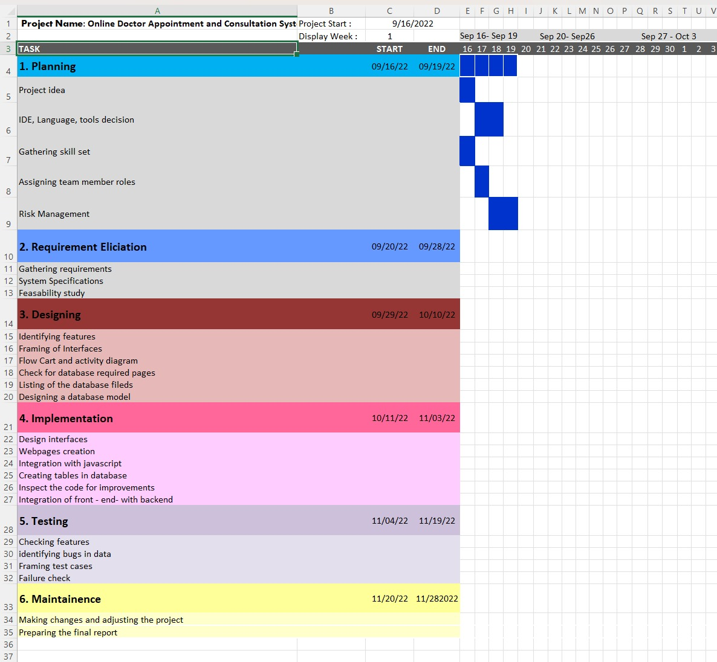
Gantt Chart:

Slide 12
Risk Management:
1.Lacking the required skills required to perform certain tasks2. Developing application by group members at different timings leads to communication gap and delay in achieving the tasks.
3.Difficulties in implementing the proper database design for the application.
4. Since the project involves five modules such as Admin, Doctor, User, Pharmacy therefore integration between these modules may involve some mistakes.
5.As project will develop by group, references of the variables involved in different modules might be mistaken.

Slide 13
Team Members Roles:
Sreeja Reddy - Design of UI, Middle layer integration from backend to frontend and frontend to backend.
Anirudh Reddy Gade - Design of UI, Backend Integration and E-R diagrams.
Vaishnavi Gawni - Design of UI, Backend and Frontend, Scheduling meetings, PPT, Gantt Chart.
Sai Vamsi Krishna Kadiyala - Implementing UI Design, PPT, Creating Database table and Writing test files.
Mukunda Priya - Gathering required resources, Design of UI, UML diagrams creation.
Vagdevi - Design of UI, Backend Integration, Documentation and PPT
Meghana Chowdary - UI design, requirement specification, Testing, Documentation and UML diagrams.
Manvitha Chowdary - Testing, UML diagrams creation and Writing test files, Backend

